Slide 1

Carpointment App
Developer: Kimberly Radway

Slide 2
Elevator Pitch
Who forgets to set their maintenance appointment even when your car alerts you that it’s due?…I know I have. With this app scheduling your appointment and getting your car in and out of the repair shop is a stress-free and quick process.

Slide 3
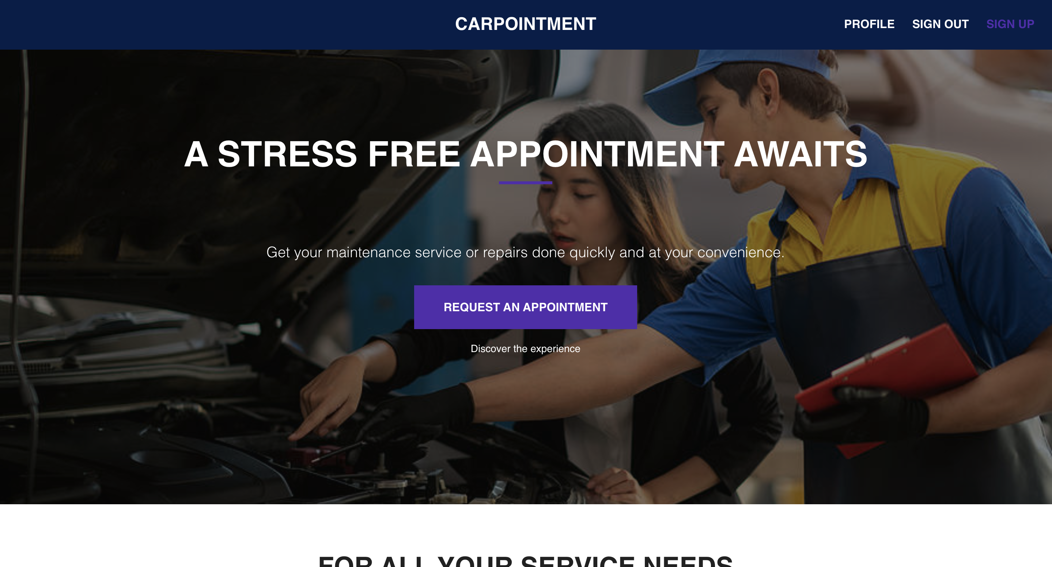

Concept
Designed to help both the customer and mechanic with a smooth appointment.

Slide 4
User Story
As a busy individual I need an app that I can use to schedule my car’s maintenance appointment and also receive notifications for when my car is ready.

Slide 5
Working in the automotive field and also being a vehicle owner I have firsthand experience on both ends as a shop manager trying to organize appointments and getting the customers car in and out quickly.
As a regular customer and a vehicle owner I sometimes forget to set my appointment to get my oil changed until it is past due.

Slide 6
Process
Tech. Used: React, Material UI, MongoDB/Mongoose, GraphQL, Custom API made from a data set from google.
Challenges: GraphyQl and DevExtreme to work with UI components, Unable to find a free API with car data that was needed, custom API was limited to only one manufacturer, limiting the users to only one type of vehicle and the amount of data displayed on front-end, request appointment button unable to navigate to profile page.
Successes: Responsive UI, ability to sign up, sign in and ability to book the appointment and save user data.

Slide 7
Demo

Slide 8
Future Development
Implement a better API with most makes & models.
Shop Maps: customer will be able to find a shop near them that has openings.
Status tracker: giving the customer the ability to track repair progress. Also receive notifications for when their car is ready and next service appointment due.
Mechanic side of app: to view customers profile with vehicle info and balance owed, also organize appointments.
Stripe Payment: customer will be able to make deposit/ pay for services.
AI Mechanic: implement an AI portal to answer questions the customer might have about their car.

Slide 9
Links
Deployed Application:
Github: https://github.com/KimTurboutique/Carpointment_App

